Slide 1
Classes and Objects in Java
Basics of Classes in Java

Slide 2
Introduction
Java is a true OO language and therefore the underlying structure of all Java programs is classes.
Anything we wish to represent in Java must be encapsulated in a class that defines the “state” and “behaviour” of the basic program components known as objects.
Classes create objects and objects use methods to communicate between them. They provide a convenient method for packaging a group of logically related data items and functions that work on them.
A class essentially serves as a template for an object and behaves like a basic data type “int”. It is therefore important to understand how the fields and methods are defined in a class and how they are used to build a Java program that incorporates the basic OO concepts such as encapsulation, inheritance, and polymorphism.

Slide 3
Classes
A class is a collection of fields (data) and methods (procedure or function) that operate on that data.
Circle
centre
radius
circumference()
area()

Slide 4
Classes
A class is a collection of fields (data) and methods (procedure or function) that operate on that data.
The basic syntax for a class definition:
Bare bone class – no fields, no methods
class ClassName
{
[fields declaration]
[methods declaration]
}
class Circle
{
// my circle class
}

Slide 5
Adding Fields: Class Circle with fields
Add fields
The fields (data) are also called the instance variables.
public class Circle
{
public double x, y; // centre coordinate
public double r; // radius of the circle
}

Slide 6
Adding Methods
A class with only data fields has no life. Objects created by such a class cannot respond to any messages.
Methods are declared inside the body of the class but immediately after the declaration of data fields.
The general form of a method declaration is:
type MethodName (parameter-list)
{
Method-body;
}

Slide 7
Adding Methods to Class Circle
public class Circle
{
public double x, y; // centre of the circle
public double r; // radius of circle
//Methods to return circumference and area
public double circumference()
{
return 2*3.14*r;
}
public double area()
{
return 3.14 * r * r;
}
}
Method Body

Slide 8
Data Abstraction
Declare the Circle class, have created a new data type – Data Abstraction
Can define variables (objects) of that type:
Circle aCircle;
Circle bCircle;

Slide 9
Class of Circle cont.
aCircle, bCircle simply refers to a Circle object, not an object itself.
aCircle
bCircle
null
null
Points to nothing
Points to nothing

Slide 10
Creating objects of a class
Objects are created dynamically using the new keyword.
aCircle and bCircle refer to Circle objects
aCircle = new Circle() ;
bCircle = new Circle() ;

Slide 11
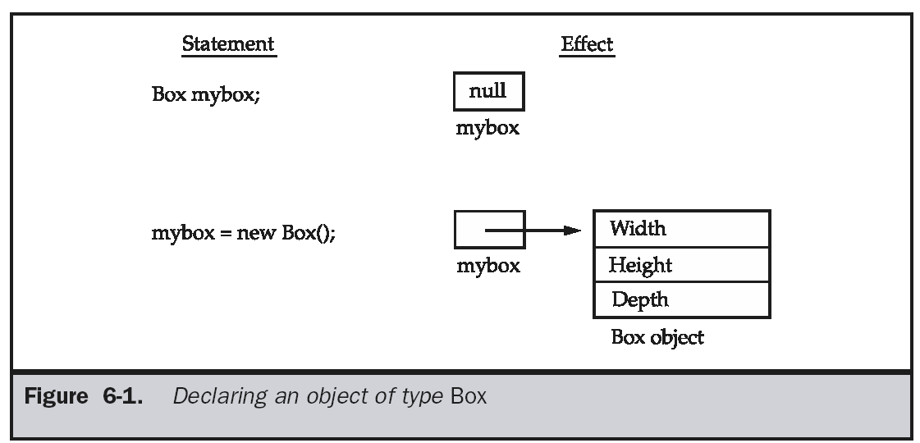

Slide 12
Creating objects of a class
aCircle = new Circle();
bCircle = new Circle() ;
bCircle = aCircle;

Slide 13
Creating objects of a class
aCircle = new Circle();
bCircle = new Circle() ;
bCircle = aCircle;
Before Assignment
After Assignment
aCircle
bCircle
aCircle
bCircle
P
Q
P
Q

Slide 14
Automatic garbage collection
Q
The object does not have a reference and cannot be used in future.
The object becomes a candidate for automatic garbage collection.
Java automatically collects garbage periodically and releases the memory used to be used in the future.

Slide 15
Accessing Object/Circle Data
Similar to C syntax for accessing data defined in a structure.
ObjectName.VariableName
ObjectName.MethodName(parameter-list)
Circle aCircle = new Circle();
aCircle.x = 2.0 // initialize center and radius
aCircle.y = 2.0
aCircle.r = 1.0

Slide 16
Executing Methods in Object/Circle
Using Object Methods:
sent ‘message’ to aCircle
Circle aCircle = new Circle();
double area;
aCircle.r = 1.0;
area = aCircle.area();

Slide 17
Using Circle Class
// Circle.java: Contains both Circle class and its user class
//Add Circle class code here
class MyMain
{
public static void main(String args[])
{
Circle aCircle; // creating reference
aCircle = new Circle(); // creating object
aCircle.x = 10; // assigning value to data field
aCircle.y = 20;
aCircle.r = 5;
double area = aCircle.area(); // invoking method
double circumf = aCircle.circumference();
System.out.println("Radius="+aCircle.r+" Area="+area);
System.out.println("Radius="+aCircle.r+" Circumference ="+circumf);
}}
C:jdk\bin> java MyMain
Radius=5.0 Area=78.5
Radius=5.0 Circumference =31.400000000000002

Slide 18
Inheritance
The objectives are:-
To explore the concept and implications of inheritance
Polymorphism
To define the syntax of inheritance in Java
To understand the class hierarchy of Java
To examine the effect of inheritance on constructors

Slide 19
Terminology
Inheritance is a fundamental Object Oriented concept
A class can be defined as a "subclass" of another class.
The subclass inherits all data attributes of its superclass
The subclass inherits all methods of its superclass
The subclass inherits all associations of its superclass
The subclass can:
Add new functionality
Use inherited functionality
Override inherited functionality
superclass:
Person
- name: String
- dob: Date
subclass:
Employee
- employeeID: int
- salary: int
- startDate: Date

Slide 20
What really happens?
In this example, we can say that an Employee "is a kind of" Person.
An Employee object inherits all of the attributes, methods and associations of Person
Person
- name: String
- dob: Date
Person
name = "John Smith"
dob = Jan 13, 1954
Employee
name = "Sally Halls"
dob = Mar 15, 1968
employeeID = 37518
salary = 65000
startDate = Dec 15, 2000
is a kind of
Employee
- employeeID: int
- salary: int
- startDate: Date

Slide 21
Inheritance in Java
Inheritance is declared using the "extends" keyword
If inheritance is not defined, the class extends a class called Object
public class Person
{
private String name;
private Date dob;
[...]
Person
- name: String
- dob: Date
public class Employee extends Person
{
private int employeID;
private int salary;
private Date startDate;
[...]
Employee
- employeeID: int
- salary: int
- startDate: Date
Employee anEmployee = new Employee();

Slide 22
Inheritance Hierarchy
Each Java class has one (and only one) superclass.
C++ allows for multiple inheritance
Inheritance creates a class hierarchy
Classes higher in the hierarchy are more general and more abstract
Classes lower in the hierarchy are more specific and concrete
There is no limit to the number of subclasses a class can have
There is no limit to the depth of the class tree.
Class
Class
Class
Class
Class
Class
Class
Class

Slide 23
Constructors and Initialization
Classes use constructors to initialize instance variables
When a subclass object is created, its constructor is called.
It is the responsibility of the subclass constructor to invoke the appropriate superclass constructors so that the instance variables defined in the superclass are properly initialized
Superclass constructors can be called using the "super" keyword in a manner similar to "this"
It must be the first line of code in the constructor

Slide 24
Constructors - Example
public class BankAccount
{
private String ownersName;
private int accountNumber;
private float balance;
public BankAccount(int anAccountNumber, String aName)
{
accountNumber = anAccountNumber;
ownersName = aName;
}
[...]
}
public class OverdraftAccount extends BankAccount
{
private float overdraftLimit;
public OverdraftAccount(int anAccountNumber, String aName, float aLimit)
{
super(anAccountNumber, aName);
overdraftLimit = aLimit;
}
}

Slide 25
Method Overriding
Subclasses inherit all methods from their superclass
Sometimes, the implementation of the method in the superclass does not provide the functionality required by the subclass.
In these cases, the method must be overridden.
To override a method, provide an implementation in the subclass.
The method in the subclass MUST have the exact same signature as the method it is overriding.

Slide 26
class A
{ int i, j; A(int a, int b) { i = a; j = b; } // display i and j void show() { System.out.println("i and j: " + i + " " + j); } }
class B extends A
{ int k; B(int a, int b, int c) { super(a, b); k = c; } // display k – this overrides show() in A void show() { System.out.println("k: " + k); } }

Slide 27
class Override
{ public static void main (String args[])
{ B subOb = new B(1, 2, 3); subOb.show(); // this calls show() in B } }
The output produced by this program is shown here:
k: 3
When show( ) is invoked on an object of type B, the version of show( ) defined within B is used. That is, the version of show( ) inside B overrides the version declared in A. If you wish to access the superclass version of an overridden function, you can do so by using super.

Slide 28
class B extends A
{ int k; B(int a, int b, int c) { super(a, b); k = c; } void show() { super.show(); // this calls A's show() System.out.println("k: " + k); } }
If you substitute this version of A into the previous program, you will see the following output:
i and j: 1 2 k: 3
Here, super.show( ) calls the superclass version of show( ). Method overriding occurs only when the names and the type signatures of the two methods are identical.

Slide 29
Final Methods and Final Classes
Methods can be qualified with the final modifier
Final methods cannot be overridden.
This can be useful for security purposes.
public final boolean validatePassword(String username, String Password)
{
[...]
Classes can be qualified with the final modifier
The class cannot be extended
This can be used to improve performance. Because there can be no subclasses, there will be no polymorphic overhead at runtime.
public final class Color
{
[...]

Slide 30
Interfaces in java

Slide 31
Why use interfaces..??
Java does not have multiple inheritance
Interface support the concept of multiple inheritance

Slide 32
Defining Interfaces
An interface in the java programming language is an
abstract type that is used to specify an interface (in the
generic sense of term) that classes must implement
Public interface MyStack
{
public int size();
public boolean isEmpty();
}
States that this is an interface not a class

Slide 33
A interface specifies a list of one or more methods giving only their signature, but no code
A class implements an interface if it supplies code for all methods of that interface
Public interface MyStack
{
public int size();
public boolean isEmpty();
}
class stack implements MyStack()
{
isEmpty(s): return (top<0);
}
Note no bodies for the methods
This will provide bodies for all the MyStack() methods
Class implements interface

Slide 34
Extending Interfaces
An interface can be sub interfaced from other interfaces
The new Sub interface will inherit all members of super interface
interface name2 extends name1
{
body of name2
}
Name 2 in sub interface
Name1 is super interface

Slide 35
interface ItemConstants
{
int code=1001;
String name=“fan”;
}
interface Item extends ItemConstants
{
void display();
}
The interface Item would inherit both the constants code and
name into it

Slide 36
Interface ItemConstants
{
int code=1001;
String name=“fan”;
}
Interface ItemMethods
{
void display();
}
Interface Item extends ItemConstants, ItemMethods
{
…………….
…………….
}

Slide 37
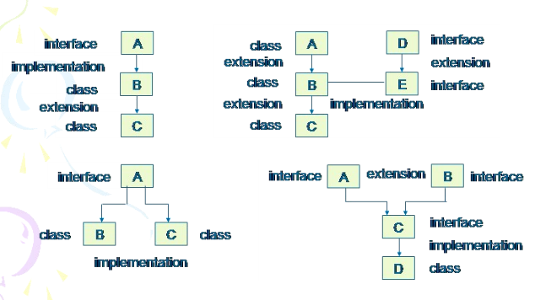
Various forms of interface implementation

Slide 38
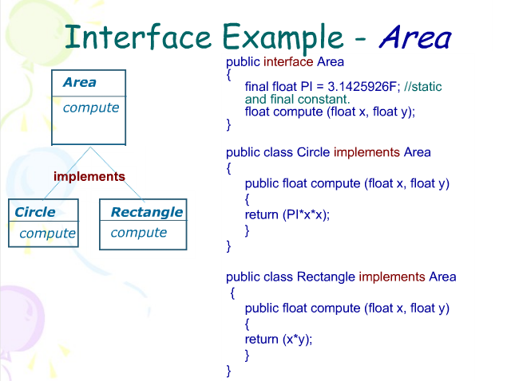

Slide 39
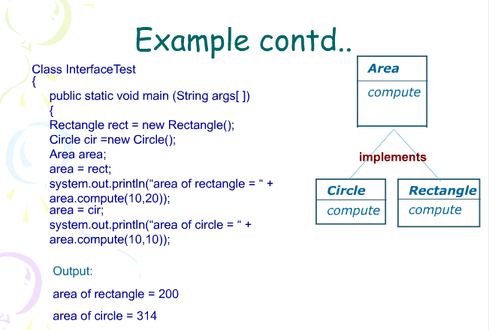

Slide 40
SIMILARITIES
Classes | Interface
An abstract class can not be instantiated | An interface can not be instantiated
A class can extend another class. A subclass can add methods and override some of its super class’s methods | An interface can extend another interface (called its super interface ) by adding declarations of abstract methods

Slide 41
DIFFERENCE
Classes | Interface
A class can extend only one class | A class can implement any number of interfaces
A class defines its own constructors (or gets a default constructor) | An interface has no constructors
A concrete class has all its methods defined. An abstract class usually has one or more abstract methods | All methods declared in an interface are abstract

